Slide 1
Agile Methodology in HamroDental with Kanban
Presented by:
Rajiv Thapa
Spandan Gurung
Sangam Shrestha

Slide 2
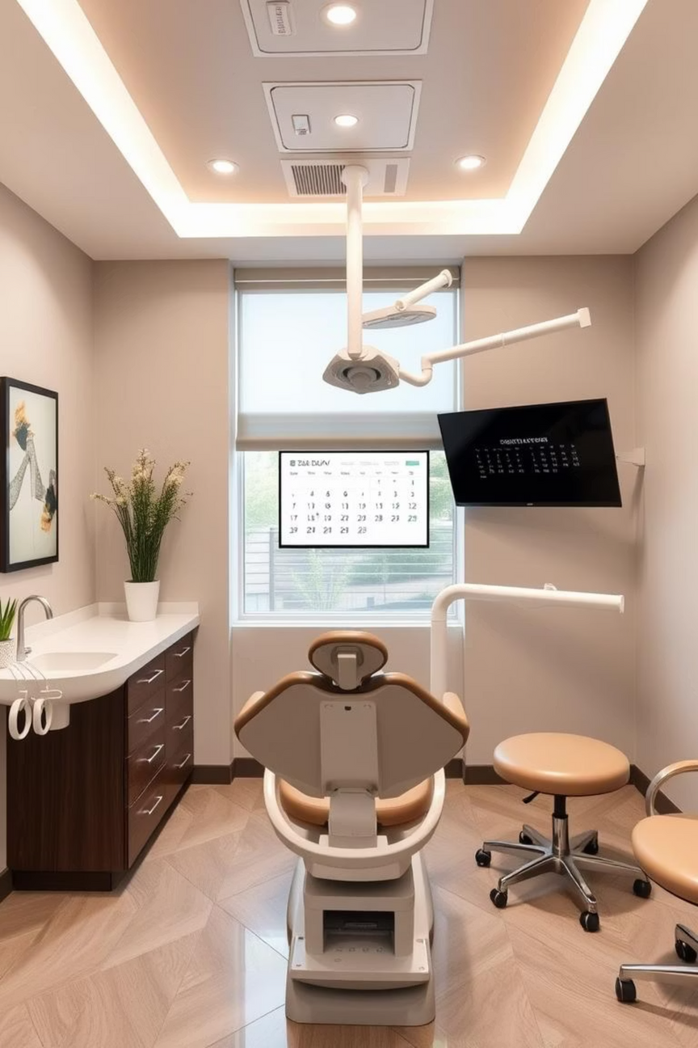
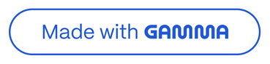
Agile Methology in HamroDental with
Welcome to our presentation on developing a seamless dental appointment system using Agile and Kanban. Our goal is to create an effortless booking and scheduling experience for both patients and staff.

Slide 3

Project Vision and Agile Approach
Our objective is to build a robust platform for dental appointment booking and scheduling. We're embracing an Agile methodology with a Kanban twist, prioritising speed, flexibility, and focused development to deliver value iteratively.

Slide 4



Meet the Development Team
Spandan: Frontend Developer
Crafting responsive, intuitive interfaces for both patients and dental staff, ensuring a smooth user experience.
Rajiv & Sangam: Backend Developers
Building robust APIs, managing secure databases, and ensuring all business logic flows seamlessly behind the scenes.
Our skilled team is dedicated to bringing this vision to life, leveraging their expertise in design and development.

Slide 5





Kanban Workflow: Visualising Progress
To Do
In Progress
Features and tasks ready for development.
Tasks currently being worked on, limiting work-in-progress.
Testing
Done
Features undergoing rigorous quality assurance and bug fixing.
Completed and deployed features, ready for user adoption.
Our Kanban board ensures clear visibility of tasks, minimises bottlenecks, and promotes rapid iteration.

Slide 6










Agile Development Phases
Daily Stand-ups
Sprint Planning
Brief team meetings to collaborate and identify any blockers.
Defining the backlog and user stories for the upcoming sprint.
Development & Testing
Coding features, running unit tests, and ensuring quality.
Retrospective
Reflecting on the sprint to identify improvements and adapt.
Sprint Review
Demonstrating new features and gathering valuable feedback.
This iterative approach allows us to continuously improve and deliver high-quality software.

Slide 7
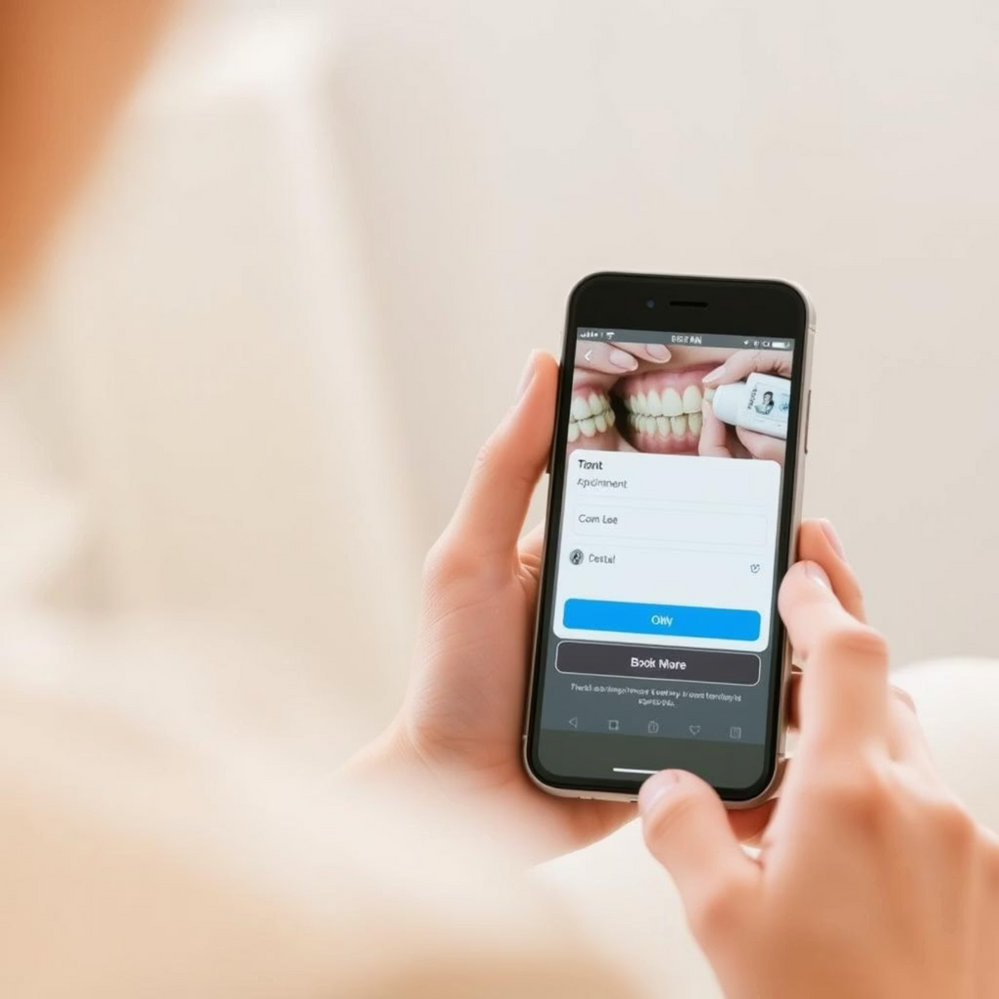
Key Features: Patient View
Effortless login and registration
Real-time dentist availability
Book, modify, or cancel appointments
SMS/email reminders for upcoming visits
Comprehensive appointment and treatment history
Designed with the patient in mind, these features ensure a convenient and stress-free booking experience.

Slide 8

Key Features: Dentist & Admin View
Manage daily appointment queues efficiently
View and edit comprehensive patient records
Add follow-up notes and treatment plans
Intuitive calendar-based scheduling
Secure role-based system access
These features empower dental professionals with the tools they need for seamless practice management.

Slide 9
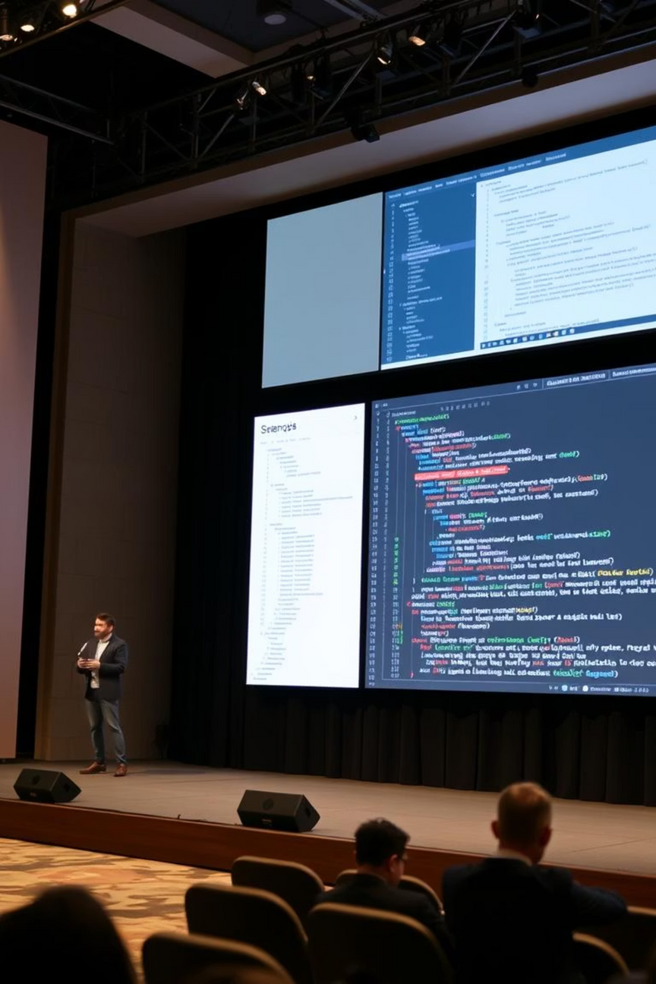
Future: Live Demo Walkthrough
During a future demonstration, we will showcase the system's functionality:
Spandan: Login Flow & UI
A walkthrough of the intuitive login process and calendar-based user interface.
Rajiv & Sangam: Backend in Action
Demonstrating the appointment API, secure data handling, and real-time availability synchronisation.

Slide 10

Roadmap: Next Steps to Success
Finalise MVP
Bringing the Minimum Viable Product to a polished, ready-to-test state.
User Testing
Conducting real-world testing with a local dental clinic to gather vital feedback.
Iterate & Refine
Implementing feedback and continuously improving the system based on user insights.
Cloud Deployment
Deploying the system on a secure cloud platform for widespread accessibility.
Our clear roadmap ensures a systematic approach to launch and ongoing enhancement.

Slide 11
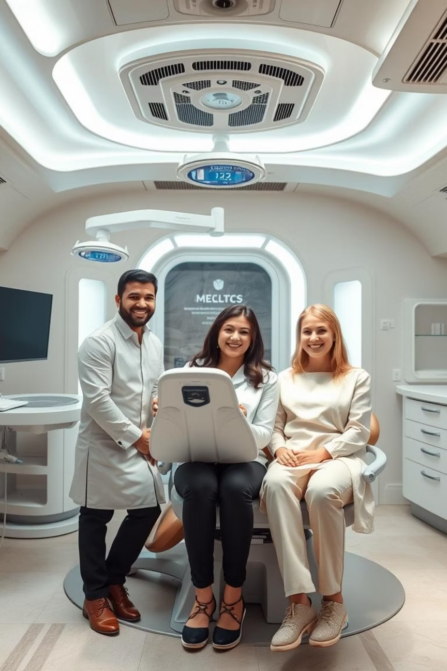
Conclusion and Future Prospects
We are excited about the potential of this Agile-driven dental appointment system to revolutionise how clinics manage their schedules and patients book appointments. Our focus on user experience, robust backend, and iterative development ensures a high-quality, scalable solution.

Slide 12
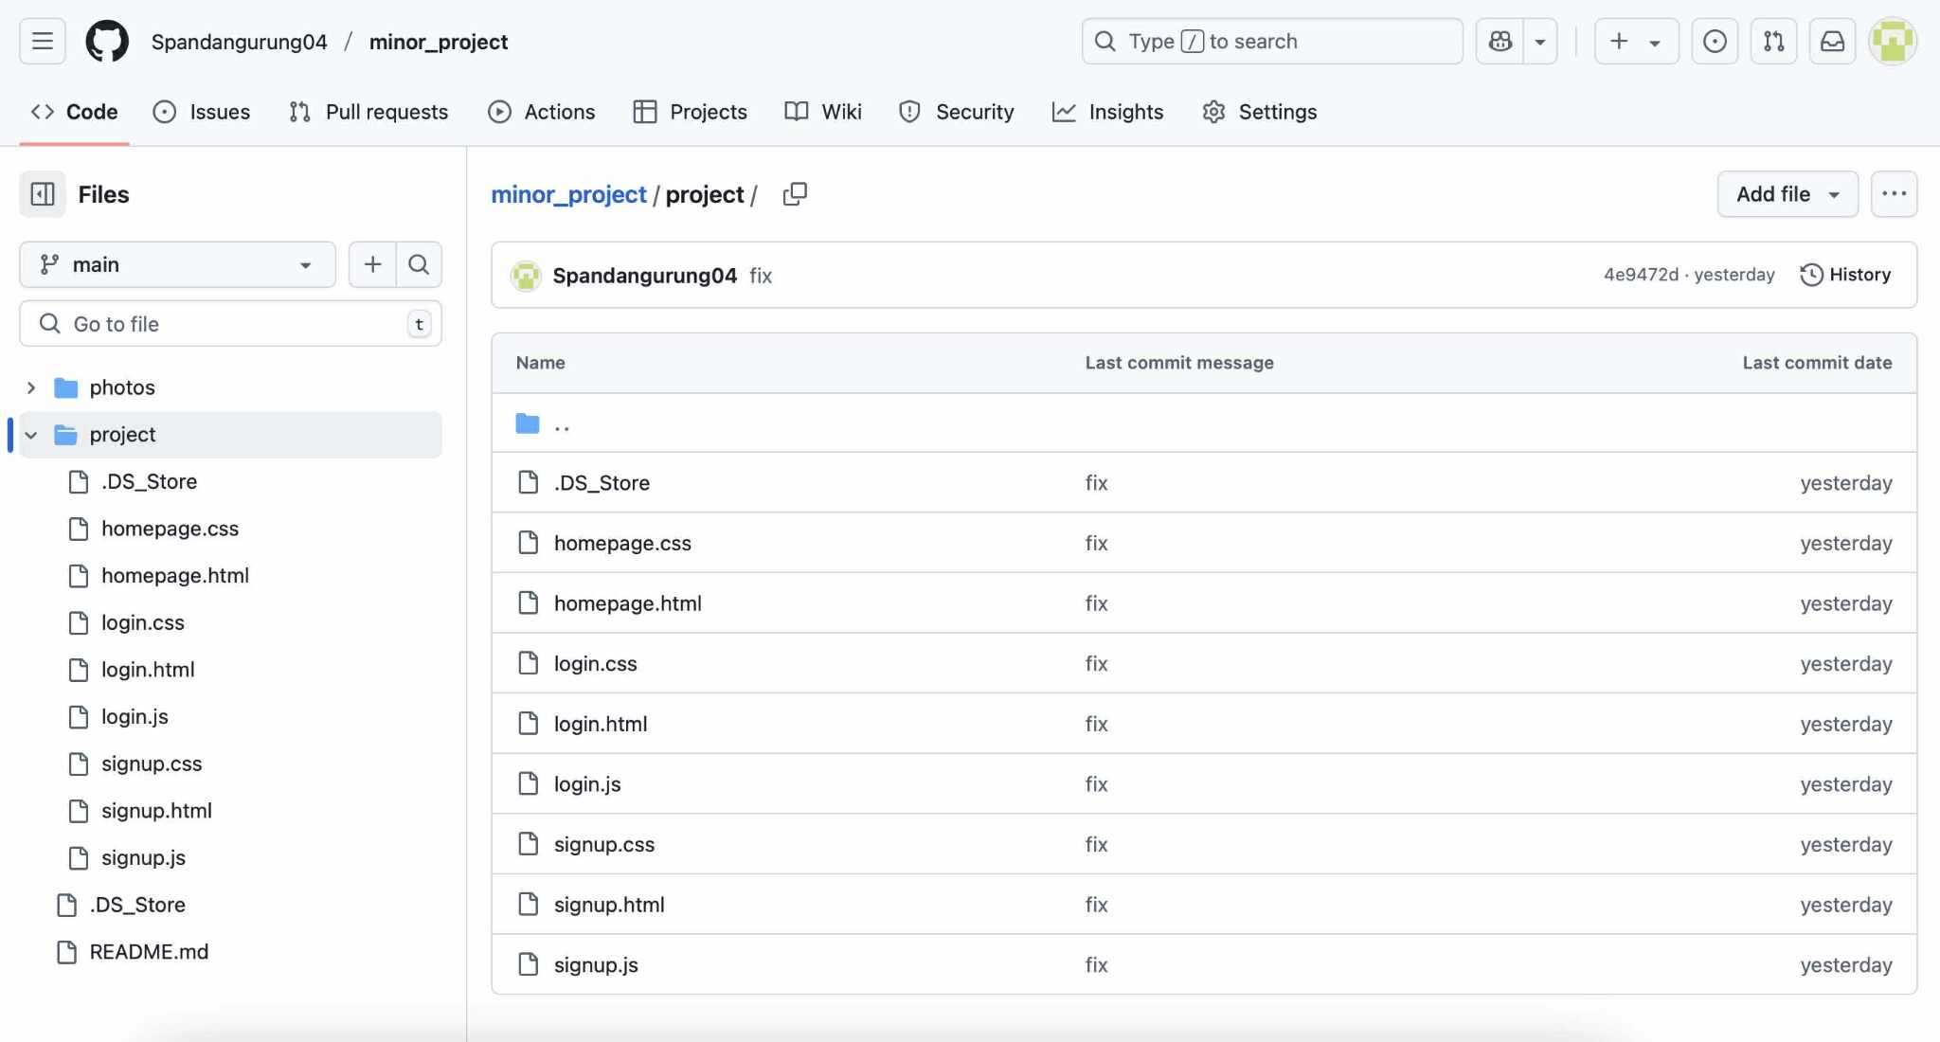

Slide 13
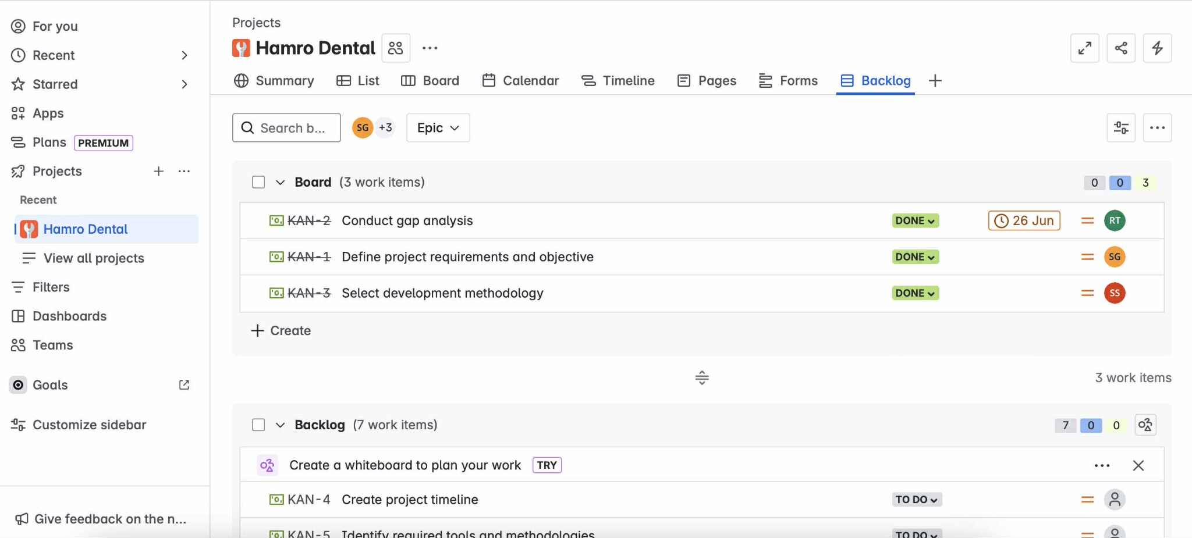

Slide 14
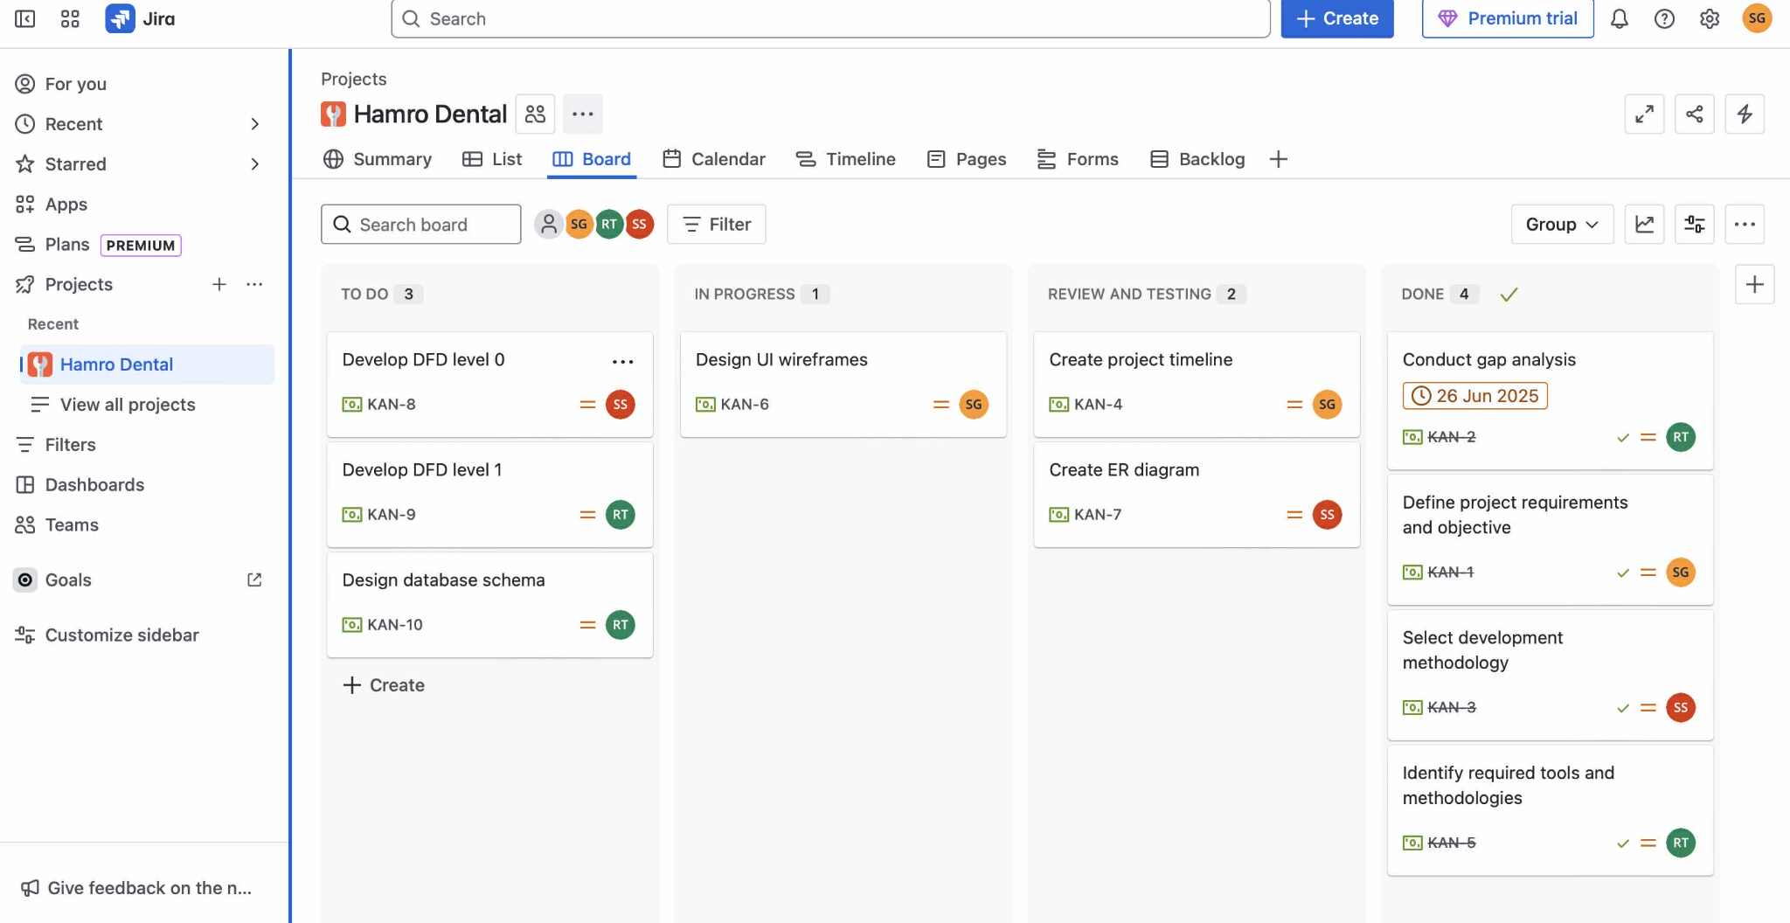

Slide 15
THANK YOU

